Slide 1

Living Standards

Slide 2

The objective of most societies is to ensure a high standard of living for all their people.
While economic growth is important, other factors such as health, education and the environment also need to be taken into account when measuring living standards.

Slide 3

The Human Development index (HDI) is an important tool for comparing the standard of living amongst countries.
The HDI includes indicators such as life expectancy, education and income to come up with a final numerical value.

Slide 4
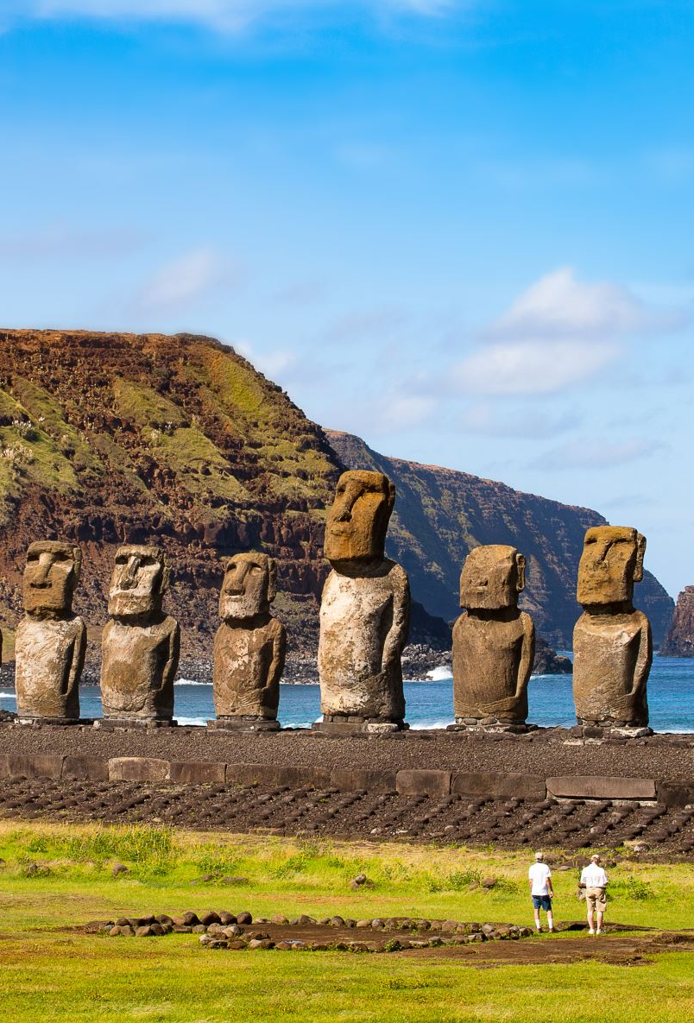
The highest ranked countries according to the HDI are from North and West Europe. Norway is ranked number 1, while Australia is ranked number 8.
The top ten countries all have more than 12 years of schooling.
Why do you think education is important as an indicator of living standards?

Slide 5

In order to get a more complete picture of the quality of people’s lives it is important to also consider qualitative indicators – those aspects not easily measured.
Qualitative indicators might include, equal rights for people, a vibrant culture, freedom of expression, a fair and just legal system, safety and a clean environment.

Slide 6

Qualitative factors are difficult to measure as they are subjective; that is they are about how people think and feel about something. However, there is a correlation between high incomes and the quality of people’s lives.
And the lyrics of a Beatles song ‘Money (That’s What I Want)’
Money don't get everything it's true
What it don't get, I can't use
Now gimme money, (that's what I want)
That's what I want, (that's what I want)

Slide 7

Activity
Using the list below, write them in order from 1 to 10 of how important you believe them to be for a good life.
Justify your ranking.

Slide 8

A Good Life
Feeling safe walking around your local area
Having a network of family and social connections
Being employed in a job which gives you satisfaction
Freedom of speech and ideas
Earning a very high income
Great transport and infrastructure
A clean environment, including air and water
Access to training, education and development opportunities
Having a good balance between work and personal time
Equal rights for all people

Slide 9

Causes in variations in living standards
Many of the world’s poorest countries were once European colonies.
Colonialism influenced the development paths of many former colonies (as well as influencing their political institutions and development).

Slide 10

Most developing countries are importers of high value manufactured goods and rely heavily on exporting their low value natural resources, for example coffee, cacao and timber.

Slide 11

Political instability impacts living standards as it can lead to conflict and civil unrest, weak political institutions and corruption.
Instead of funds being devoted to improving people’s lives through social infrastructure they are often diverted to the police and military.

Slide 12

Many less developed countries have borrowed money from wealthier countries to foster economic growth. However, they are now in a ‘debt trap’. This is a situation in which a debt is difficult or impossible to repay.

Slide 13

Expenditure on armaments contribute to a countries’ debt burden. A strong military is often used to support ruling elites. This drains resources from those things that might improve living standards.

Slide 14

The End
Thank You

